Slide 1
Branch and bound

Slide 2
Introduction
Branch and bound approach is a systematic approach for solving optimization problems
A problem requiring maximum or minimum result depending on problem – Optimization problems
Branch and bound is used when greedy / dynamic technique fails to solve the problem – finding optimal solution
It explores the entire search space of possible solutions and provides an optimal solution.
A branch and bound algorithm consist of stepwise enumeration of possible candidate solutions by exploring the entire search space

Slide 3
Much slower, often leads to exponential time complexity in worst case.
On the other hand, if handled carefully, it can lead to algorithm that runs reasonably fast in average case.
In general, it’s a BFS approach for optimal solution but not all nodes are expanded.
This technique can be implemented as a state space tree with BFS applied to find the optimal solution. We use selected criteria to determine which node to be expanded and when the node gets expanded.
Another criteria is when the algorithm can find the optimal solution.

Slide 4
Both BFS and DFS are used in Branch and Bound technique
BFS technique is FIFO like search in terms of live nodes and the list of live nodes are represented in form of a queue.
DFS technique is LIFO like search in terms of live nodes and the list of live nodes are represented in form of a stack.
Least Cost set is based on the minimum cost.
These are the various techniques used in Branch and Bound.

Slide 5
The travelling salesman problem (also called the travelling salesperson problem or TSP) asks the following question: "Given a list of cities and the distances between each pair of cities, what is the shortest possible route that visits each city and returns to the origin city?“
TSP can be modelled as an undirected weighted graph, such that cities are the graph's vertices, paths are the graph's edges, and a path's distance is the edge's weight. It is a minimization problem starting and finishing at a specified vertex after having visited each other vertex exactly once. Often, the model is a complete graph (i.e. each pair of vertices is connected by an edge). If no path exists between two cities, adding an arbitrarily long edge will complete the graph without affecting the optimal tour.
https://www.youtube.com/watch?v=SC5CX8drAtU

Slide 6
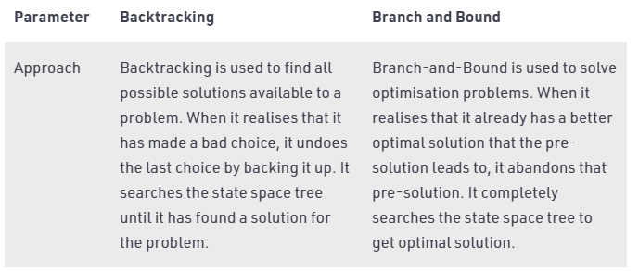

Slide 7
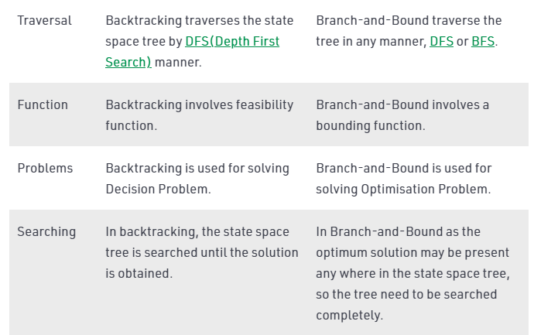

Slide 8
